Slide 1
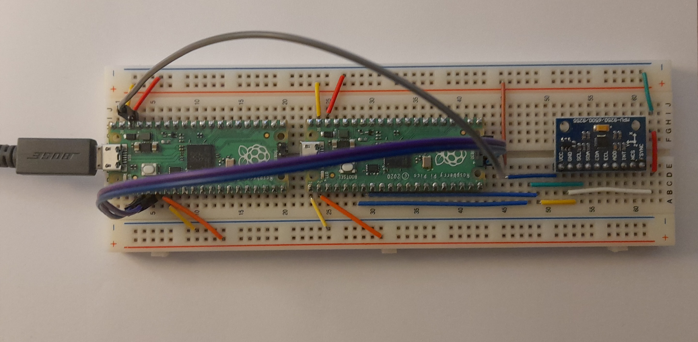
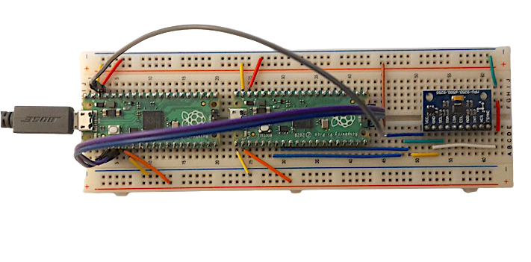

Slide 2
Picoprobe
Raspberry Pi pico
MPU9250
USB

